Slide 1


Insurance Analytics Dashboard
A comprehensive data-driven analysis of insurance performance metrics, business intelligence visualizations, and strategic insights
Group 3 Project Team
🎓 Mentor: Sreenivas
🧑‍💼 Project Manager: B. Harish
Pratik Raut
Jyoti Yadav
Karvendra Singh
Asha Rathod
Syed Asif

Slide 2
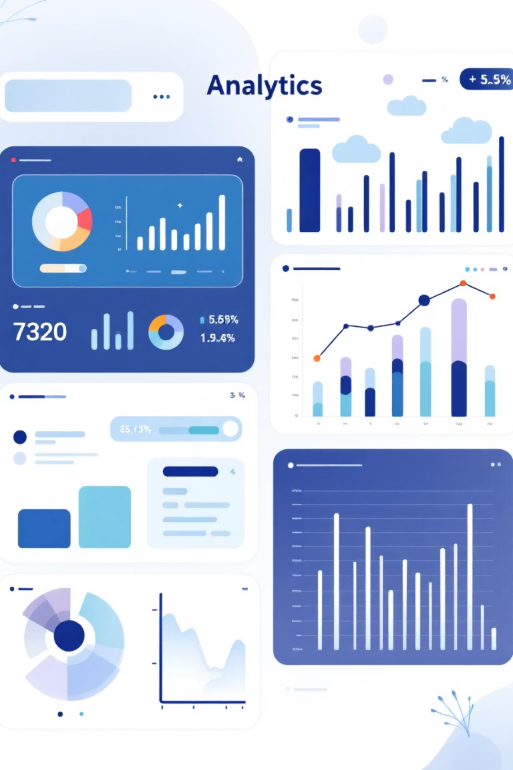
Project Summary
The Insurance Analytics Dashboard is a comprehensive solution designed to provide real-time insights into insurance operations performance. It enables key stakeholders—including underwriters, claims teams, and executives—to make informed, data-driven decisions by consolidating critical metrics and advanced analytics into a single, user-friendly interface.
Core KPI Tracking
Total Policy
Stage Funnel by Revenue
Loss Ratios
Policy Retention
Conversion Rates
Claims
Open Opportunities
Age – wise policies
Gender – wise policies
Expiring policy this year
This integrated platform transforms raw data into actionable intelligence, supporting strategic planning and operational efficiency across the organization.

Slide 3
KPIs & Performance Metrics
150%
68%
65%
Renewal Achievement
Renewal Invoice
Cross-Sell Placement
Outstanding renewal placement performance
Strong invoice conversion rate
Cross-sell target achievement
Performance Tracking by Business Segment
Cross-Sell
New Business
Renewal
Target: $20.08M
Target: $19.67M
Target: $12.32M
Achieved: $12.64M
Achieved: $3.43M
Achieved: $18.50M
Invoiced: $3.04M
Invoiced: $0.83M
Invoiced: $8.39M
Placement: 65% | Invoice: 15%
Placement: 18% | Invoice: 4%
Placement: 150% | Invoice: 68%

Slide 4
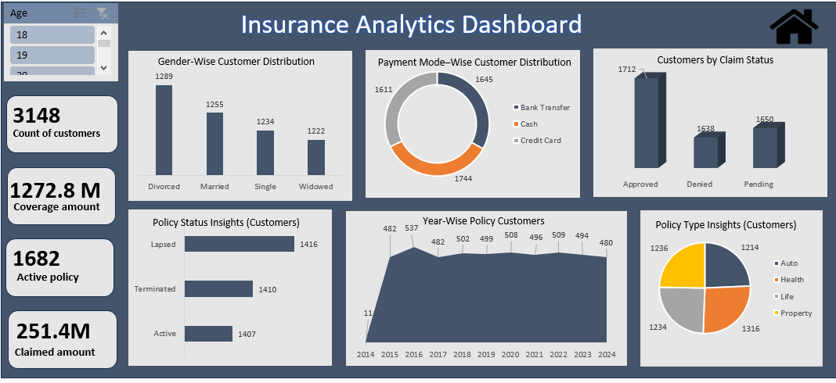
Excel Dashboard Implementation
Our Excel-based analytics dashboard provides foundational data visualization and reporting capabilities, offering stakeholders quick access to key performance indicators through familiar spreadsheet interfaces.
Dynamic Visualizations
Automated Reporting
Interactive charts and pivot tables enable real-time data exploration and trend analysis
Built-in formulas calculate KPIs automatically, reducing manual calculation errors
User Accessibility
Familiar Excel interface ensures rapid adoption
across all team members

Slide 5
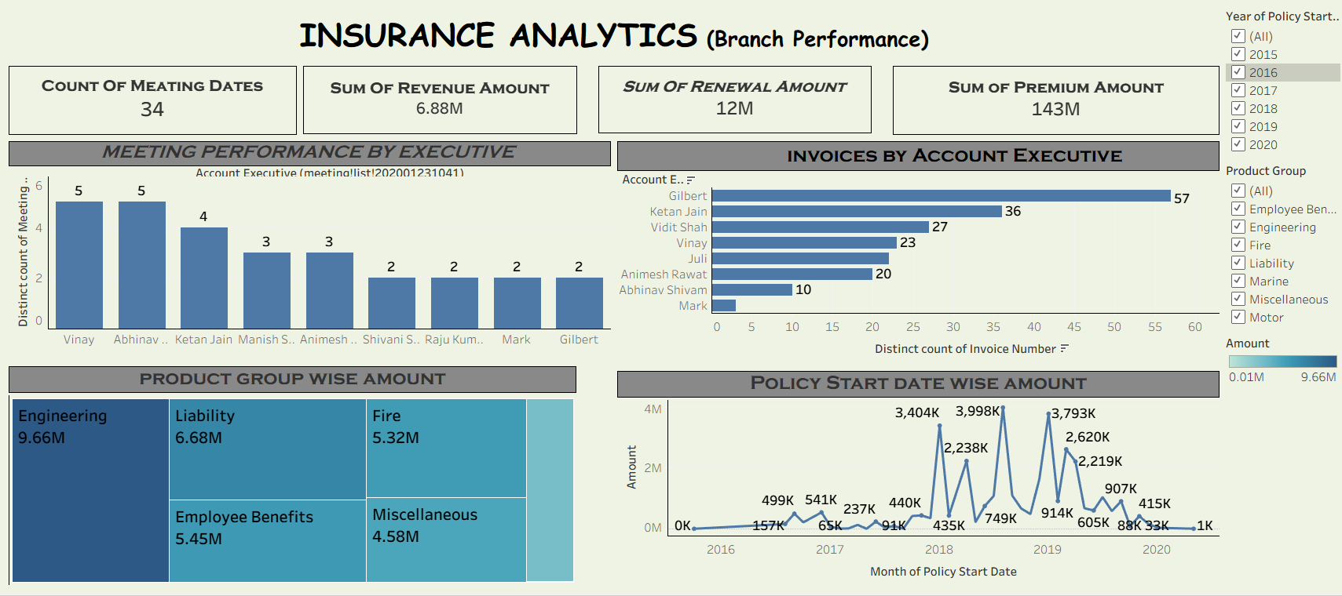
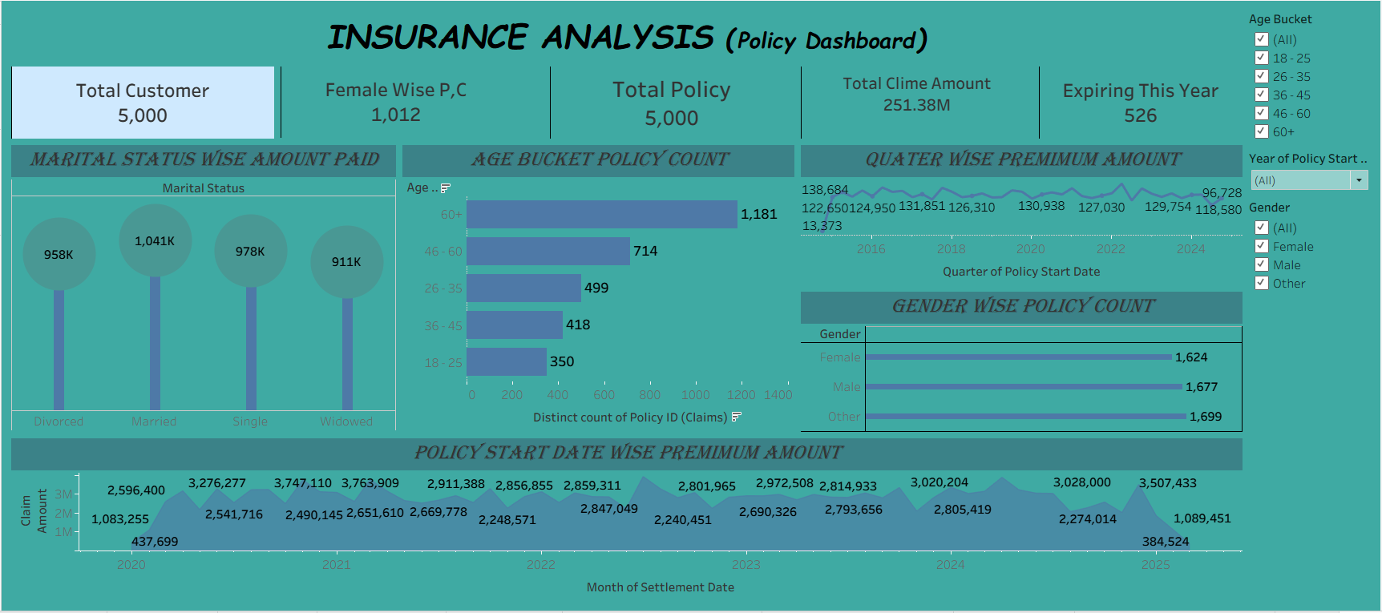
Tableau Dashboard Visualization
The Tableau implementation elevates our analytics capabilities with sophisticated interactive visualizations, allowing executives to drill down into data segments and uncover hidden patterns through intuitive visual exploration.
Advanced Features
Tableau's powerful visualization engine transforms complex insurance datasets into clear, actionable insights that drive strategic decision-making across the organization.
Real-time data connectivity and refresh capabilities
Custom calculated fields for complex metrics
Interactive filtering across multiple data dimensions
Mobile-responsive design for on-the-go insights

Slide 6
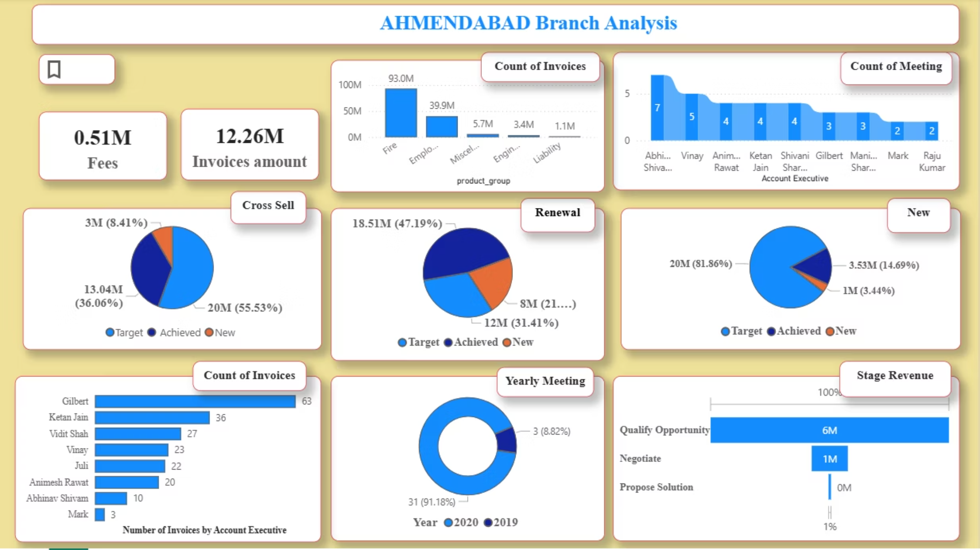
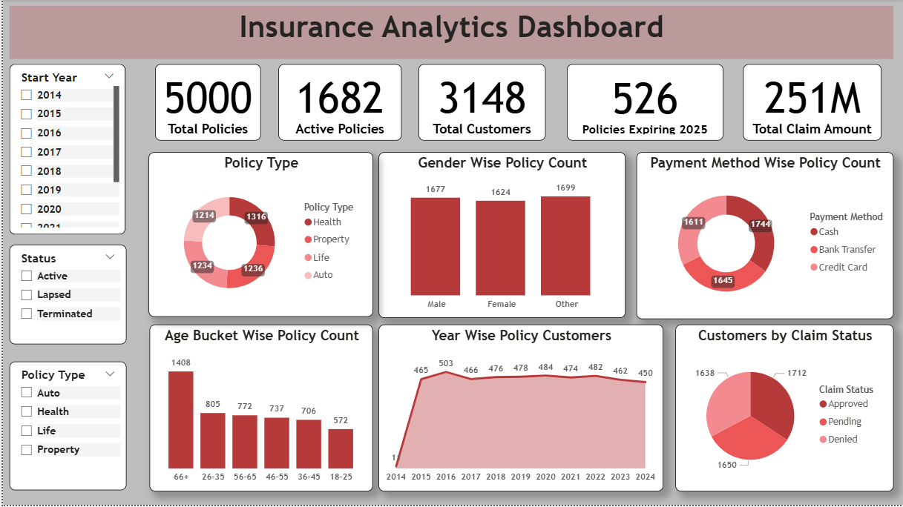
Power BI Dashboard Analytics
Enterprise Integration
AI-Powered Insights
Collaborative Sharing
Seamlessly connects with Microsoft ecosystem and enterprise data sources
Leverages machine learning to identify trends and generate predictive analytics
Enables secure report distribution and collaborative decision-making workflows
Power BI serves as our enterprise-grade analytics solution, providing robust security, scalability, and advanced analytical capabilities that support complex insurance operations.

Slide 7

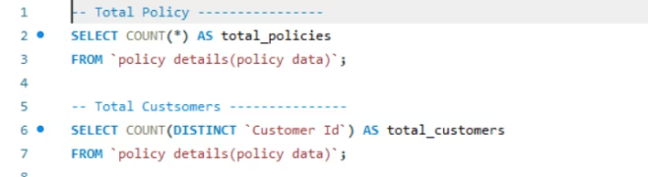
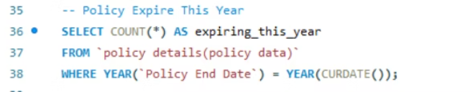
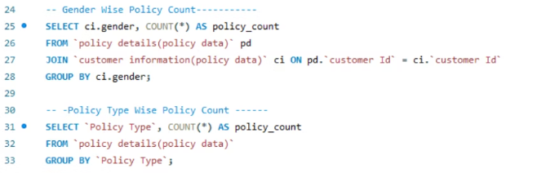
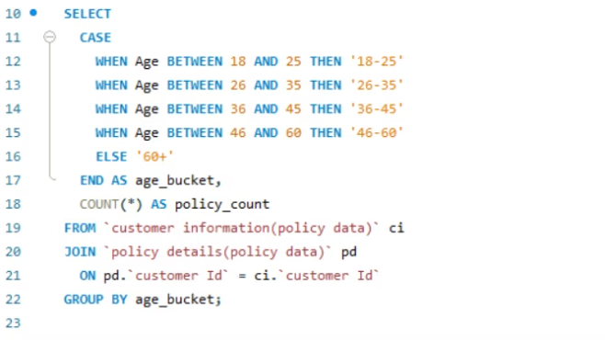
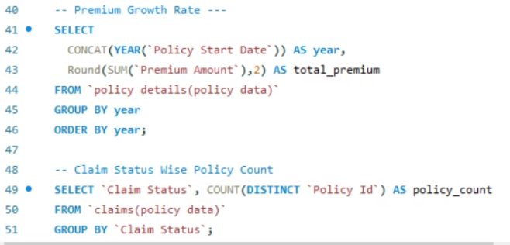
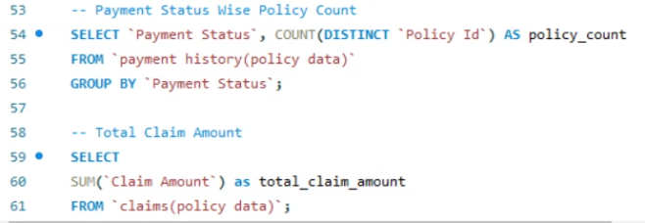
SQL Query Implementation
Our analytics foundation relies on sophisticated SQL queries that extract, transform, and aggregate insurance data from multiple sources, ensuring data accuracy and consistency across all dashboard platforms.
Data Extraction Queries
Performance Optimization
Aggregation Logic
Data Validation

Slide 8
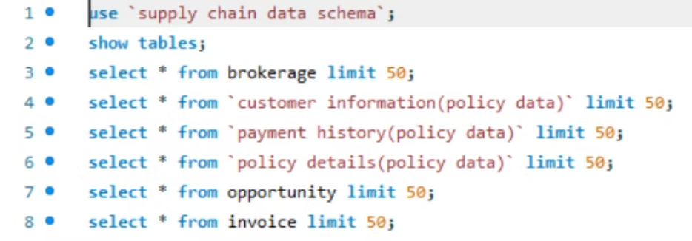
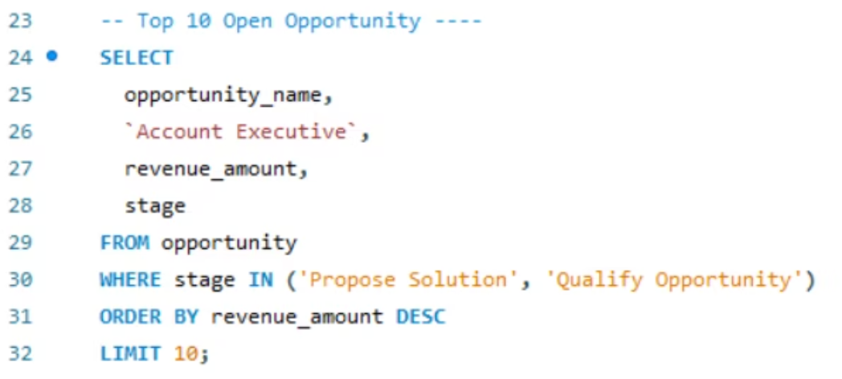
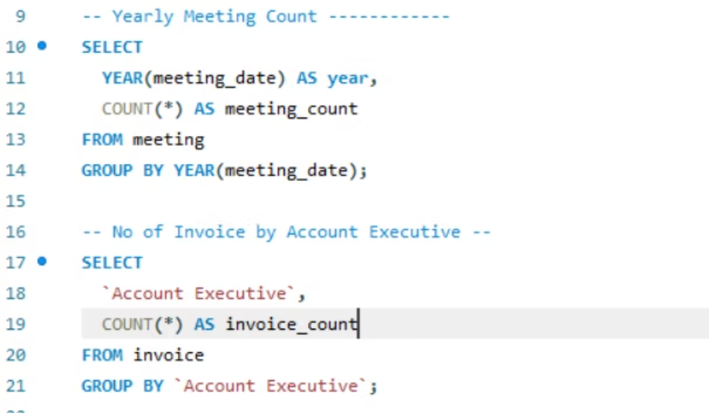
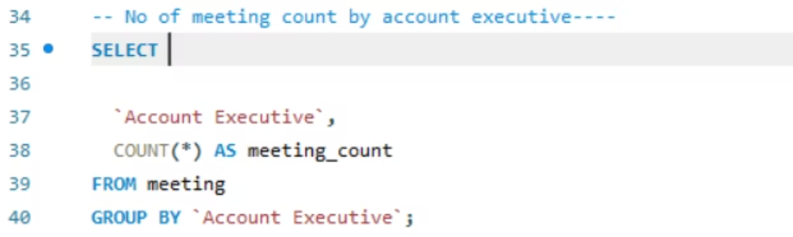

Advanced SQL Analytics
Complex SQL queries enable sophisticated business intelligence by joining multiple data tables, calculating derived metrics, and implementing business logic directly at the database level for optimal performance.
Business Logic Queries
Analytical Calculations
1
2
3
Data Integration
KPI Calculation
Performance Tuning
Combines policy, claims, and customer data from disparate systems
Computes achievement percentages and variance analysis
Optimized indexes and query execution plans ensure rapid response times

Slide 9




Key Business Insights
Executive Activity
Gilbert and Vinay lead in invoice generation, while Abhinav Shivam conducted 7 meetings, demonstrating proactive client engagement
Opportunity Pipeline
Most revenue stuck in "Qualify Opportunity" stage with minimal progression to "Propose Solution" or "Negotiate" phases
Performance Gaps
Cross-sell shows 65% placement but only 15% invoice achievement, indicating conversion challenges
Cross-Sell Challenge
New Business Weakness
Renewal Strength
High budget ($20M+) with weak conversion:
Exceptional performance:
Significantly underperforming:
Placement: 150%
Placement: 65%
Invoice: 68%
Invoice: 15%
Placement: 18%
Invoice: 4%

Slide 10
Strategic Recommendations
01
02
Enhance Sales Funnel Management
Improve Conversion Rates
Train account executives on moving opportunities from "Qualify" to "Negotiate" stages through targeted coaching programs
Review pricing structures and offer configurations for cross-sell and new business segments to boost invoice achievement
03
04
Optimize Executive Performance
Leverage Renewal Success
Set minimum benchmarks for meetings and opportunities, implement leaderboards and recognition programs
Analyze renewal segment best practices and apply learnings to improve new business acquisition strategies
Critical Challenges
Next Steps
Low conversion in early funnel stages
Implement systematic tracking of meeting impact on conversion success rates and establish customer feedback loops to continuously improve the sales process across all business segments.
Weak invoice achievements in Cross-Sell and New segments
Uneven performance among executives
Limited meeting frequency impacting opportunity wins

Slide 11


Presented by:
Karvendra Singh |Pratik Raut |Jyoti Yadav|Asha Rathod|Syed Asif
Mentored by:
Srinivas
Managed by:
B. Harish

